Slide 1



Poloniana
Redefining Digital Safety & Learning in Telegram
Andrzej Jaworski
TON NEST

Slide 2
Vision:
Poloniana is a Telegram-native Web3 mini-app aiming to make security and crypto education easy, engaging, and rewarding

Slide 3
Problem:
Telegram users are vulnerable to scams, phishing, and poor crypto hygiene. There's no native, engaging tool to teach users security practices.

Slide 4



Solution:
Educational mini-courses inside Telegram
Gamified rewards and digital identity features
- Seamless onboarding & Web3 incentives

Slide 5
Features Overview
⚡ Security Courses
🎓 Crypto Basics
🏆 XP, Badges, Leaerboards
Telegram – centric design
🎁 Rewards for engagement (SBT, NFT, toens)

Slide 6
Why Telegram + TON?
900M+ users
Native Web3 support (TON ntegration)
Instant virality through groups, channels & bots

Slide 7



Monetization
Premium courses
Branded challenges (sponsored security tasks)
Digital collectible identity passes

Slide 8





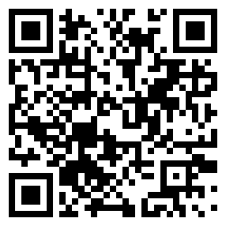
Current Stage
Logo
Concept
Branding
Telegram Mini App MVP in planning
Design ongoing

Slide 9
Roadmap
Q3 2025: Alpha community + MVP testing
Q4 2025: Full launch + gamified leaderboard
2026: Expand into digital identity + SocialFi

Slide 10
Personal message
I’m not claiming to have the best project in the world — I’m just someone with a lot of ideas, and this one truly lit a spark in me.
I see a real problem, and I want to be among the first to solve it. I believe Telegram can become not just a secure space, but also a place that empowers and educates people through modern tools, smart digital environments, and real community value.
I’m building this from the ground up and learning along the way. That’s why I’m looking for support, funding, mentorship, and guidance — not only to make this project a reality but to grow with it.
With the right help, I believe we can make something meaningful — something that brings both security and innovation into the Web3 and Telegram space.

Slide 11
Team / Contact /Footer
Telegram: @andrzejaworski
Https://t.me/Poloniana

